Slide 1


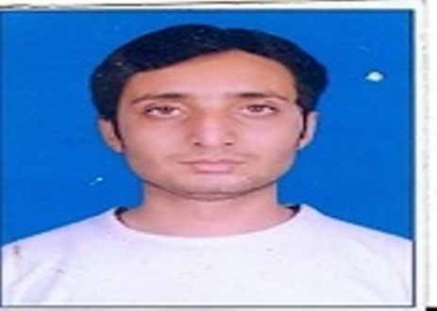

Noida Institute of Engineering and Technology, Greater Noida
Introduction to UHV2
Unit: I
Understanding the human being comprehensively-Human Aspirations and its fulfillment
(KOE 069)
Sudhanshu Kumar
ASSISTANT PROFESSOR
ELECTRICAL AND ELECTRONICS ENGINEERING
B Tech (6th Sem)
Sudhanshu Kumar KOE 069 & Universal Human Values 2 Unit I

Slide 2
Faculty Introduction
M.Tech : UPTU, Lucknow
B.Tech : RVU, Udaipor
Research Interests : FSO
Academic Experience : (10 years)
Publication : International Journal : 1 , International Conference: 3
National Journal : 1
Sudhanshu Kumar KOE 069 & Universal Human Values 2 Unit I

Slide 3
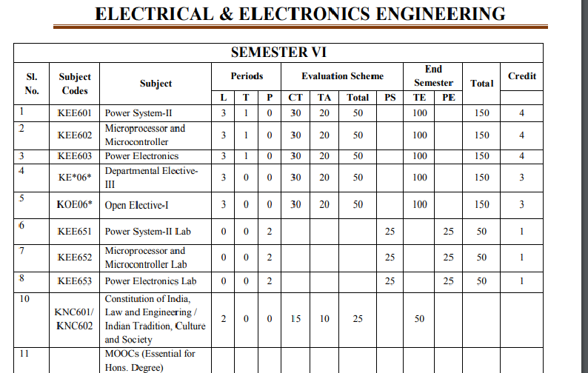
Evaluation Scheme
Sudhanshu Kumar KOE 069 & Universal Human Values 2 Unit I

Slide 4
Syllabus
Unit 1 Introduction: The basic human aspirations and their fulfillment through Right understanding and Resolution; All-encompassing Resolution for a Human Being, its details and solution of problems in the light of Resolution.
Unit 2 Understanding Human being and its expansion: The domain of right understanding starts from understanding the human being (the knower, the experience and the doer); and extends up to understanding nature/existence – its interconnectedness and co-existence; and finally understanding the role of human being in existence (human conduct).
Unit 3 Activities of the Self: Understanding the human being comprehensively is the first step and the core theme of this course; human being as co-existence of the self and the body; the activities and potentialities of the self; Reasons for harmony/contradiction in the self.
Sudhanshu Kumar KOE 069 & Universal Human Values 2 Unit I

Slide 5
Syllabus
Unit 4 Understanding Co-existence with other orders: The need and the process of inner evolution (through self-exploration, self- awareness and self-evaluation)- particularly awakening to activities of the Self: Realization, Understanding and Contemplation in the Self (Realization of Co-Existence,)
Unit 5 Expansion of harmony from self to entire existence: Understanding different aspects of All-encompassing Resolution (understanding, wisdom, science etc.), Holistic way of living for Human Being with All-encompassing Resolution covering all four dimensions of human Endeavour viz., realization, thought, behavior and work (participation in the larger order) leading to harmony at all levels from self to Nature and entire Existence..
Sudhanshu Kumar KOE 069 & Universal Human Values 2 Unit I

Slide 6
Branch wise application
Administrative Authority
Administrative Staff
Teachers
Students
Sudhanshu Kumar KOE 069 & Universal Human Values 2 Unit I

Slide 7
Course Objective
Unit 1 | To help the students having the clarity about human aspirations, goal, activities and purpose of life.
Unit 2 | To facilitate the competence to understand Self of Human being.
Unit 3 | To help the students to develop the understanding of human tradition and its various components.
Unit 4 | To help the students to develop the understanding of work behaviour.
Unit 5 | To help the students to develop the understanding of nature and co-existence.
Sudhanshu Kumar KOE 069 & Universal Human Values 2 Unit I

Slide 8
Course Outcome
CO1 | Students will understand the clarity about human aspirations, goal, activities and purpose of life.
CO2 | Students will understand the human self.
CO3 | Students will develop the understanding of human tradition and its various components.
CO4 | Students will develop the understanding of work and mutual prosperity.
CO5 | Students will develop the understanding of nature and co-existence.
Sudhanshu Kumar KOE 069 & Universal Human Values 2 Unit I

Slide 9
Program Outcomes
PO1. Engineering knowledge: Apply the knowledge of mathematics, science, engineering fundamentals, and an engineering specialization for the solution of complex engineering problems.
PO2. Problem analysis: Identify, formulate, research literature, and analyze complex engineering problems reaching substantiated conclusions using first principles of mathematics, natural sciences, and engineering sciences.
PO3. Design/development of solutions: Design solutions for complex engineering problems and design system components or processes that meet the specified needs with appropriate consideration for public health and safety, and cultural, societal, and environmental considerations.
PO4. Conduct investigations of complex problems: Use research based knowledge and research methods including design of experiments, analysis and interpretation of data, and synthesis of information to provide valid conclusions.
Sudhanshu Kumar KOE 069 & Universal Human Values 2 Unit I

Slide 10
Program Outcomes
PO5. Modern tool usage: Create, select, and apply appropriate techniques, resources, and modern engineering and IT tools, including prediction and modeling to complex engineering activities, with an understanding of the limitations.
PO6. The engineer and society: Apply reasoning informed by the contextual knowledge to assess societal, health, safety, legal and cultural issues and the consequent responsibilities relevant to the professional engineering practice.
PO7. Environment and sustainability: Understand the impact of the professional engineering solutions in societal and environmental contexts, and demonstrate the knowledge of, and need for sustainable development.
PO8. Ethics: Apply ethical principles and commit to professional ethics and responsibilities and norms of the engineering practice.
Sudhanshu Kumar KOE 069 & Universal Human Values 2 Unit I

Slide 11
Program Outcomes
PO9. Individual and team work: Function effectively as an individual, and as a member or leader in diverse teams, and in multidisciplinary settings.
PO10. Communication: Communicate effectively on complex engineering activities with the engineering community and with the society at large, such as, being able to comprehend and write effective reports and design documentation, make effective presentations, and give and receive clear instructions.
PO11. Project management and finance: Demonstrate knowledge and understanding of the engineering and management principles and apply these to one’s own work, as a member and leader in a team, to manage projects and in multidisciplinary environments.
PO12. Life-long learning: Recognize the need for, and have the preparation and ability to engage in independent and life-long learning in the broadest context of technological change.
Sudhanshu Kumar KOE 069 & Universal Human Values 2 Unit I

Slide 12
CO-PO Mapping
S.No | CO | PO 1 | PO 2 | PO 3 | PO 4 | PO5 | PO6 | PO7 | PO 8 | PO 9 | PO 10 | PO 11 | PO 12
1 | CO1 | - | - | - | - | - | 3 | - | 3 | 3 | - | - | 3
2 | CO2 | - | - | - | - | - | 1 | 3 | 3 | 3 | - | - | 1
3 | CO3 | - | - | - | - | - | 3 | 1 | 3 | 2 | - | - | 2
4 | CO4 | - | - | - | - | - | 3 | 1 | 3 | 2 | - | - | 2
5 | CO5 | - | - | - | - | - | 3 | 1 | 3 | 2 | - | - | 2
Sudhanshu Kumar KOE 069 & Universal Human Values 2 Unit I

Slide 13
Program Specific Outcomes
PSO1: Apply fundamental knowledge to identify, formulate, design and investigate various problems of electrical and electronic circuits, power electronics, and power systems.
PSO2: Apply modern software tools for design, simulation and analysis of electrical systems to engage in life- long learning and to successfully adapt in multi-disciplinary environments.
PSO3: Solve ethically and professionally various Electrical Engineering problems in societal and environmental context and communicate effectively.
Sudhanshu Kumar KOE 069 & Universal Human Values 2 Unit I

Slide 14
CO-PSO Mapping
Mapping of Program Specific Outcome and Course Outcome:
Program Specific Outcomes | Course Outcomes
 | CO1 | CO2 | CO3 | CO4 | CO5
PSO1 | - | - | - | - | -
PSO2 | - | - | - | - | -
PSO3 | 1 | 1 | 1 | 1 | 1
Sudhanshu Kumar KOE 069 & Universal Human Values 2 Unit I

Slide 15
Program Educational Objective
Our current PEOs are as follow:
PEO1 - Graduates will demonstrate technical competency and leadership to become professional engineers leading to a successful career.
PEO2 - Graduates will demonstrate commitment towards sustainable development for the betterment of society.
PEO3 - Graduates will pursue lifelong learning in generating innovative engineering solutions using research and complex problem-solving skills.
Sudhanshu Kumar KOE 069 & Universal Human Values 2 Unit I

Slide 16
Result analysis
Semester VI…. Year & Session _......III........ (2020-2021) EVEN
Overall branch result %
Total number of students | Students clear passed | Result % of clear passed
36 | 36 | 100
Section | Result % of clear passed
A | 100
Section wise result % =
Faculty wise Result analysis
Name of Faculty Member | Subject Codes | Subject Name | Result % of clear passed | Average Marks
Sudhanshu Kumar | KOE069 | UHV 2 | 100 | 83.61
Sudhanshu Kumar KOE 069 & Universal Human Values 2 Unit I

Slide 17

End semester question paper
Sudhanshu Kumar KOE 069 & Universal Human Values 2 Unit I

Slide 18
Prerequisite
Prerequisite
Course will be accessible to most students who have completed their first three years of study at an Undergraduate level.
Course will be accessible to students who have completed the course AUC-001 or RVE 301/401 “Universal Human Values and Professional Ethics”
Recap
Students should have studied the UHVPE 1(RVE 301/401) & clear about Basic Human Aspiration –Continuous Happiness and its Fulfillment.
Sudhanshu Kumar KOE 069 & Universal Human Values 2 Unit I

Slide 19
Introduction of Subject with video
Understanding The Human Being Comprehensively – Human Aspirations and Its Fulfillment detail syllabus for 2019-20 scheme is taken from AKTU official website and presented for AKTU students.
The course code (ROE074), and for exam duration, Teaching Hr/Week, Practical Hr/Week, Total Marks, internal marks, theory marks, and credits do visit complete sem subjects post.
https://www.youtube.com/watch?v=HLp5GzkDRvU&list=PLsh2FvSr3n7doww8dqQ9YIL2G66tWZQz3
Sudhanshu Kumar KOE 069 & Universal Human Values 2 Unit I

Slide 20
Unit content
Introduction
Aim of UHV2
UHV1 Recap – Aspiration
UHV1 Recap - HB & Existence
Self is Central
Basic Human Aspiration: Continuous Happiness and its Fulfillment
Summary
Daily Quiz
Weekly assignment
MCQ’s
Previous year Question papers
Expected Questions for University exam
Sudhanshu Kumar KOE 069 & Universal Human Values 2 Unit I

Slide 21
Unit objective
To help the students having the clarity about human aspirations, goal, activities and purpose of life.
Sudhanshu Kumar KOE 069 & Universal Human Values 2 Unit I

Slide 22
Topic Objective
TO1 | Describe the human being
TO2 | Difference between human and animal being
TO3 | Meaning of education is explained
Sudhanshu Kumar KOE 069 & Universal Human Values 2 Unit I

Slide 23
Topic Mapping with CO
Topics | Topic Name | CO1
TO1 | Self exploration | 1
TO2 | Harmony of 4 levels | 2
TO3 | Understanding | 1
Sudhanshu Kumar KOE 069 & Universal Human Values 2 Unit I

Slide 24
Self-Exploration (CO1)
Whatever is said is a Proposal (Do not accept it to be true)
Verify it on your own right
1
2
Experiential Validation
Live according to it
Verify
on the basis
Of
your
Natural
Acceptance
2a
2b
Behaviour with
Human Beings
Work with
Rest of Nature
Mutual Happiness
Mutual Prosperity
Which process is Naturally Acceptable to you?
A process of self-exploration on your own right, leading to understanding in your self
or
A process of discourse, do’s & don’ts, in which you assume what is said
Sudhanshu Kumar KOE 069 & Universal Human Values 2 Unit I

Slide 25
Background
We exist as human being. We want to live a fulfilling life. We have some desires and we have some programs for the fulfillment of it.
It is important for us to understand our basic aspiration and program for its fulfillment correctly and comprehensibly. Only then, we can ensure the fulfillment.
This is what we have been trying to do in UHV1. We want to study it in further depth in this course (UHV2)
The goal of this course (UHV2) can be viewed as follows
Sudhanshu Kumar KOE 069 & Universal Human Values 2 Unit I

Slide 26
Goal of this Course (UHV2)
To explore the human reality (its being, basic aspiration, its fulfilment), particularly the Self, in more depth
    Self is central to human existence
To explore deeper into the nature and existence as co-existence
    co-existence is central to existence
    everything that we see in nature and existence is the natural expression and unfolding of this co-existence
To understand the role of human being in further detail, in the light of the above
    To understand the co-existence
    To have the feeling and the thought of co-existence
    To live in co-existence in mutual relation with human being and the rest of nature
Sudhanshu Kumar KOE 069 & Universal Human Values 2 Unit I

Slide 27
Our Purpose & Program depends on Assumption/ Understanding about:
In UHV1, we have seen that knowingly or unknowingly, we have assumed some purpose in life and we have some program for the fulfillment of the set purpose.
This setting up of the purpose and program depends upon our assumptions about:
  Human Being
  Existence
We had some assumptions about these two before UHV1
And now these assumptions have been modified through the process of self-exploration that we went through in the UHV1 course.
Let us look at some details of this shift in our assumptions.
Sudhanshu Kumar KOE 069 & Universal Human Values 2 Unit I

Slide 28
Shift in Our Assumptions / Understanding through UHV1
Assumptions
Human Being =
Existence =
Purpose =
Program =
Before UHV1
Body ?
Material ?
Happiness
[through sensation, feeling from other] ?
Accumulation of physical facility (unlimited!) ?
After UHV1
Self Body
Units submerged in space
Continuous happiness and
Prosperity (Happiness is to be in a state of harmony)
To understand and to live in harmony (at all levels of being – human being, family, society, nature/existence)
Co-existence
Sudhanshu Kumar KOE 069 & Universal Human Values 2 Unit I

Slide 29
Shift 1
UHV1 is focused on:
  To initiate the process of self-exploration in you
  The realization that human being is co-existence of Self and Body
  Which in turn leads to the shift in perception
Sudhanshu Kumar KOE 069 & Universal Human Values 2 Unit I

Slide 30
Shift 1
Assumption: ‘Human Being is Body’
Purpose: Expectation to live with continuous happiness (effort to be made outside and not within – I am OK, problem is with others)
Seeking happiness through physical facility, sensation & feeling from other
Requirement of physical facility is undefined/unlimited
Program: Accumulation of physical facility (unlimited!)
Knowing: ‘Human Being is coexistence of Self and Body’
Purpose: Desire to live with continuous happiness (effort to be made within and then outside)
Continuous happiness = To be in harmony at all levels of being
Physical facility is required only for nurturing, protecting and right utilisation of body. Need of PF is defined, limited in quantity
Program: To understand & to live in harmony at all levels of being
UHV1
Sudhanshu Kumar KOE 069 & Universal Human Values 2 Unit I

Slide 31
Shift 1
 | Before UHV1 | After UHV1
Assumption | Human being is physical facility, the Body | Human being is the co-existence of Self and Body
Goal | Happiness through physical facility / sensation (transitory) | Happiness and prosperity (continuous)
Program | Getting favourable sensation, accumulation of physical facility | Right understanding, relationship and physical facility
Khushboo ROE- 074 & Universal Human Values 2 Unit I

Slide 32
With UHV1 following must have happened – Your Qualification for UHV2
You have concluded that this content about the existential reality is relevant for you. It is your own need to understand it in depth
On the basis of the effort you have put in to understand this content and to live accordingly, you have concluded that
    You have to work on your Self first
    You are responsible for your happiness and unhappiness;
    The other or the situations are only a triggering point
You are able to see that you are the co-existence of Self and Body. While most of the effort you may have been making are for fulfilling the needs of the Body; you expect/desire to further understand the co-existence of the Self with the Body and live accordingly
You are able to see that the whole existence is not just material; there is space and submerged in space are material as well as consciousness units
Sudhanshu Kumar KOE 069 & Universal Human Values 2 Unit I

Slide 33
Your Qualification for UHV2 – Rephrased for Self-evaluation
Your attention is beginning to be drawn toward your Self
    Shift from thoughts like "I am special; I have to dominate over others"
    You have started thinking about “what is my real goal, as a human being”
    You have started becoming aware of your desires, thoughts & expectations
    There is less contradiction within.
You are realising that the goal is more than 'accumulation of physical facility'
    You are thinking about prosperity (versus accumulation of physical facility)
    You are able to see that everyone can be prosperous
Sudhanshu Kumar KOE 069 & Universal Human Values 2 Unit I

Slide 34
Your Qualification for UHV2 – Rephrased for Self-evaluation
You are realising the significance of relationship
    You can see that feeling is central in relationship
    You are realising that having the feelings in yourself and expressing these feelings to the other is the source of your happiness
    Expecting the feelings from the other is enslavement and can not be a source of continuous happiness. visible improvement in reaction, irritation, anger
You can see that you have to first develop your own competence
    Effort to first correct the other or the situation outside has reduced/stopped
You have decided to understand things in depth yourself
    You have questions for which you are committed to find answers
Sudhanshu Kumar KOE 069 & Universal Human Values 2 Unit I

Slide 35
Home Work
Since UHV1, what effort are you making for self-exploration on a regular basis? What is the outcome of it? Share 3 specific achievements.
Sudhanshu Kumar KOE 069 & Universal Human Values 2 Unit I

Slide 36
Expected Shift through UHV2
If we have undergone the shift1 through UHV1, mentioned in the last lecture, we are ready to work for further shift (shift2) through the process of self-exploration in UHV2. It has become our need to understand the existential reality in depth and to live accordingly.
Otherwise, we need to keep working hard for ensuring shift1 along with working for shift2. It is needless to say that the task now is going to be far more difficult and challenging. However, if we have realised the acute need for it, we will be able to do it.
We will now try to get an idea about the shift that is expected to take place, if we go through the process of self exploration in this course.
Sudhanshu Kumar KOE 069 & Universal Human Values 2 Unit I

Slide 37
UHV2 is designed for the further shift
The focus of UHV2 is to help for the second shift to take place, i.e. to see that:
‘The Self (I) is central to human existence
Body is used as an Instrument'
    The need of the Self is continuous happiness [Need of the Self(I)]
Which is fulfilled by
    Understanding co-existence [Activity of Self(I)]
    Feeling & thought of co-existence
This is expressed naturally in the form of
    Mutually fulfilling behavior with human being
    Mutually enriching work with rest of nature
    Participation in larger order leading to undivided society and universal human order
Sudhanshu Kumar KOE 069 & Universal Human Values 2 Unit I

Slide 38
Total Shift through UHV1 and UHV2
Realising: ‘The Self (I) is central to human existence
Body is used as an Instrument'
    I desire for continuous happiness (to be in harmony) – Need of Self(I)
    Which is fulfilled by – Activity of Self(I)
        Understanding of co-existence
        Feeling & thought of co-existence
Understanding: ‘Human Being is coexistence of Self (I) & Body’
    I think/desire for continuity of happiness & prosperity. Physical facility is required for nurturing, protecting and right utilisation of body
    My program is to understand & to live in harmony at all levels of being
  Assuming: ‘Human Being is Body’
    I expect continuous happiness & prosperity from physical facility, sensation & feeling from other. Requirement of physical facility is undefined/unlimited
    Accumulation of physical facility is my program
U
H
V1
U
H
V1
Sudhanshu Kumar KOE 069 & Universal Human Values 2 Unit I

Slide 39
Total Shift through UHV1 and UHV2
Assumptions
Human Being =
Existence =
Purpose =
Program =
After UHV1
Self Body
Units submerged in space
Consciousness Material
Continuous happiness and
prosperity
(Happiness is to be in a state of harmony)
To understand and to live in harmony (at all levels of being – human being, family, society, nature/existence)
Expected after UHV2
Self is central. Body is used as an instrument
Units submerged in space
Consciousness Material
Continuous happiness
(Happiness is to be in a state of co-existence)
Prosperity is a part of it
To understand co-existence
To have the feeling and thought of co-existence
To live in co-existence
co-existence
Sudhanshu Kumar KOE 069 & Universal Human Values 2 Unit I

Slide 40
Understanding through UHV2
Realising:
  ‘The Self (I) is central to human existence
  Body is used as an Instrument'
    Desire of Human being is for
    continuous happiness (to be in harmony) – Need of Self(I)
    Which is fulfilled by – Activity of Self(I)
      Understanding of co-existence
      Feeling and thought of co-existence
Sudhanshu Kumar KOE 069 & Universal Human Values 2 Unit I

Slide 41
Understanding through UHV2
Two important points to be noted are:
  The need for the feeling of prosperity is a part of being in a state of continuous happiness (to be in harmony at all levels)
  Expression in mutual relation with human being and rest of nature, in terms of behaviour and work, is a natural outcome of understanding of co-existence and feeling & thought of co-existence
Sudhanshu Kumar KOE 069 & Universal Human Values 2 Unit I

Slide 42
Our Exploration and Understanding from HVPE (UHV1)
The foundation course in HVPE (UHV1 in case of AKTU) is a prerequisite for this course.
Therefore, before we proceed, let us recall some of the basic concepts that we have explored in the HVPE (UHV1) course.
Sudhanshu Kumar KOE 069 & Universal Human Values 2 Unit I

Slide 43
Basic Human Aspiration and its Fulfillment
The basic human aspiration is for continuity of happiness and prosperity
This is fulfilled by living in human consciousness, by ensuring right understanding, right feeling and physical facility
Transformation from animal consciousness to human consciousness is ensured through human education-sanskar
Living with human consciousness provides the base for ensuring justice and order leading to undivided society and universal human order.
Sudhanshu Kumar KOE 069 & Universal Human Values 2 Unit I

Slide 44
Role of Education-Sanskar: To Enable Transformation
HUMANS
ANIMALS
Necessary but not complete
Necessary and complete
1. Right understanding
To live solely on this basis is called ANIMAL consciousness
2. RELATIONSHIP
3. PHYSICAL FACILITIES
Mutual happiness
Mutual
Prosperity
TRANSFORMATION
To live with all three is called HUMAN consciousness.
This is where we want to be.
Khushboo ROE- 074 & Universal Human Values 2 Unit I

Slide 45
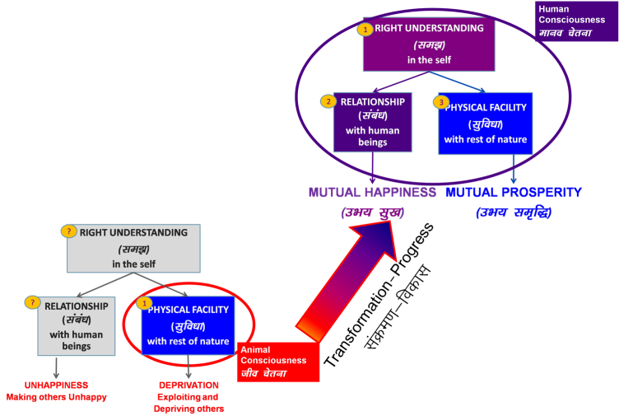
Role of Education-Sanskar: To Enable Transformation
Basic Human Desire:
Happiness and prosperity → continuity
It is fulfilled by (program for fulfillment):
Right understanding in the Self (I)
Right feeling in relationship
Recognition of required physical facility
and its fulfillment with rest of nature
Sudhanshu Kumar KOE 069 & Universal Human Values 2 Unit I

Slide 46
Humane and Inhuman Society
Humane Society
Inhuman Society
Right Understanding & Right Feelings
Prosperity
Fearlessness
(Trust)
Co-Existence
(mutual enrichment)
In Every Individual
In Every Family
In Society
In Nature/ Existence
Assumptions (eg. Money is everything)
Accumulation
By Any Means
Domination ,
Exploitation, Fear
Mastery &
Exploitation
In Every Individual
In few Individuals
In Society
Over Nature
Obsession for Consumption
“ for Profit
“ for Sensual Pleasure
Terrorism
War
Resource Depletion
Pollution
Sudhanshu Kumar KOE 069 & Universal Human Values 2 Unit I

Slide 47
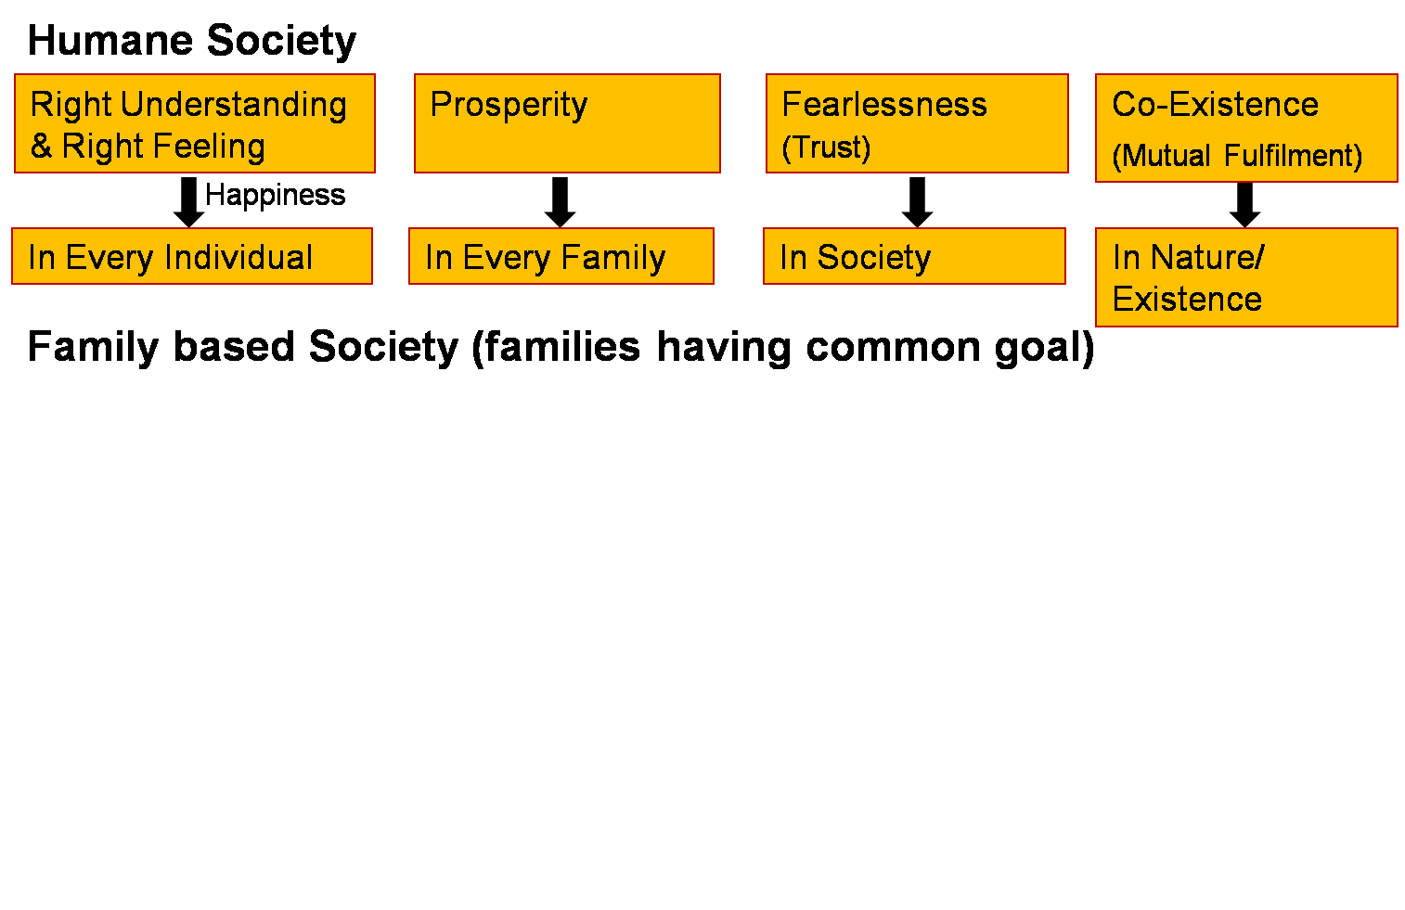
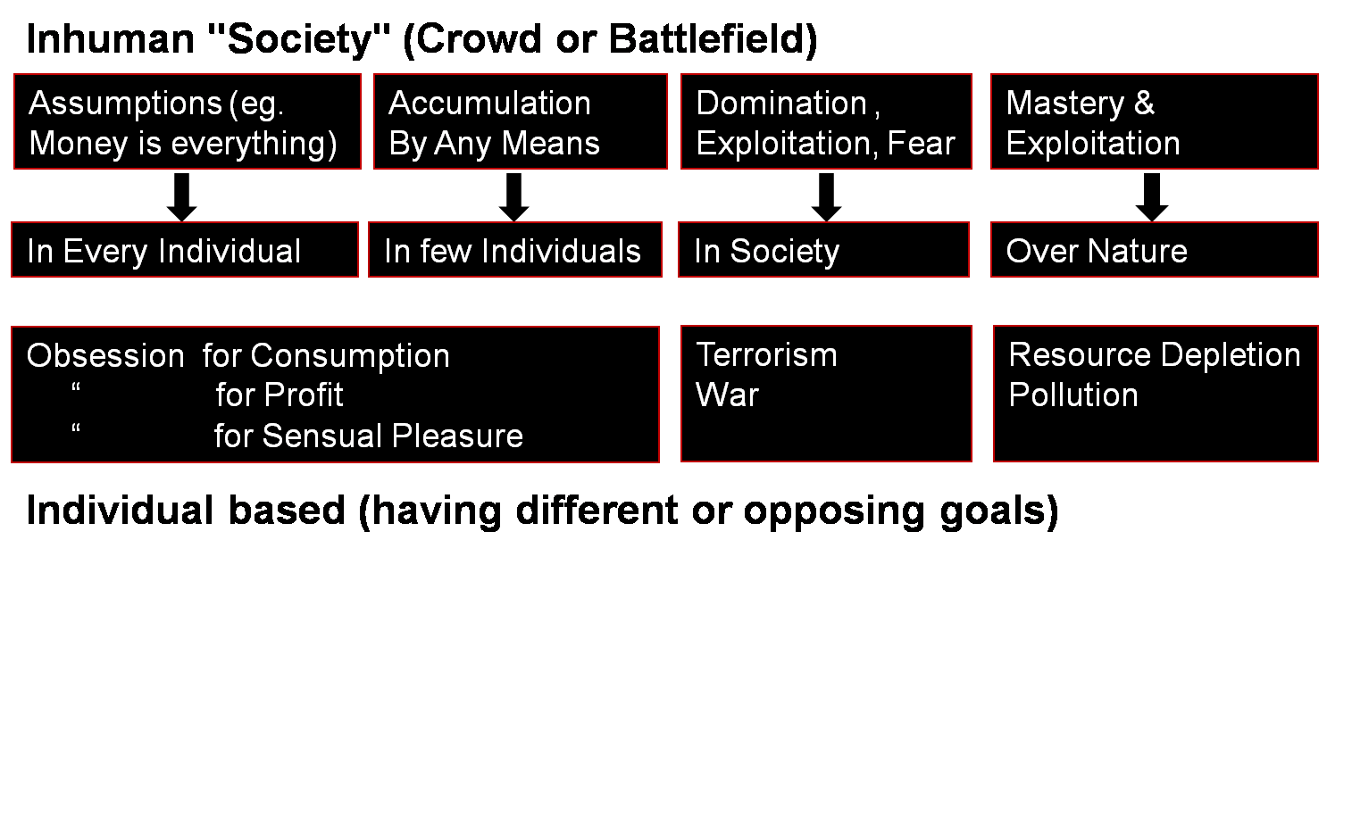
Transformation:
Animal Consciousness to Human Consciousness
Human Education
Personal Transformation
Societal Transformation
Transformation& Progress
Sudhanshu Kumar KOE 069 & Universal Human Values 2 Unit I

Slide 48
Home Work
The basic human aspiration is continuous happiness and prosperity. Having assumed / understood this, how have the priorities of your life changed?
Sudhanshu Kumar KOE 069 & Universal Human Values 2 Unit I

Slide 49
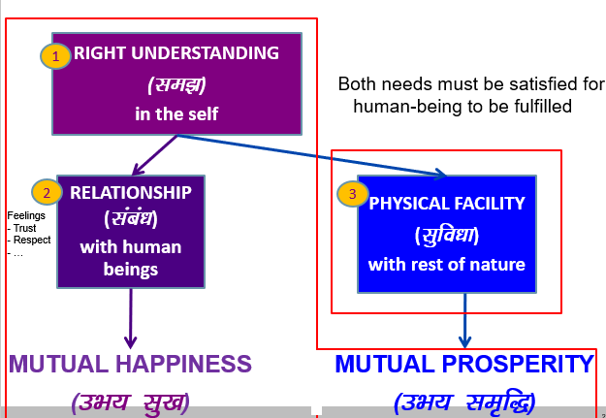
Need of Self and Body
Sudhanshu Kumar KOE 069 & Universal Human Values 2 Unit I

Slide 50
Understanding the Needs of Self (I) & Body
Co-existence
lgvfLrRo
Human Being | Self (I) | Body
Need | Happiness (e.g. Respect) | Physical Facility (e.g. Food)
In Time | Continuous | Temporary
In Quantity | Qualitative (is Feeling) | Quantitative (Required in Limited Quantity)
Fulfilled By | Right Understanding & Right Feeling | Physio-chemical Things
Activity | Desire, Thought, Expectation… | Eating, Walking…
In Time | Continuous | Temporary
Response | Knowing, Assuming, Recognising, Fulfilling | Recognising, Fulfilling
 | Consciousness | Material
Khushboo ROE- 074 & Universal Human Values 2 Unit I

Slide 51
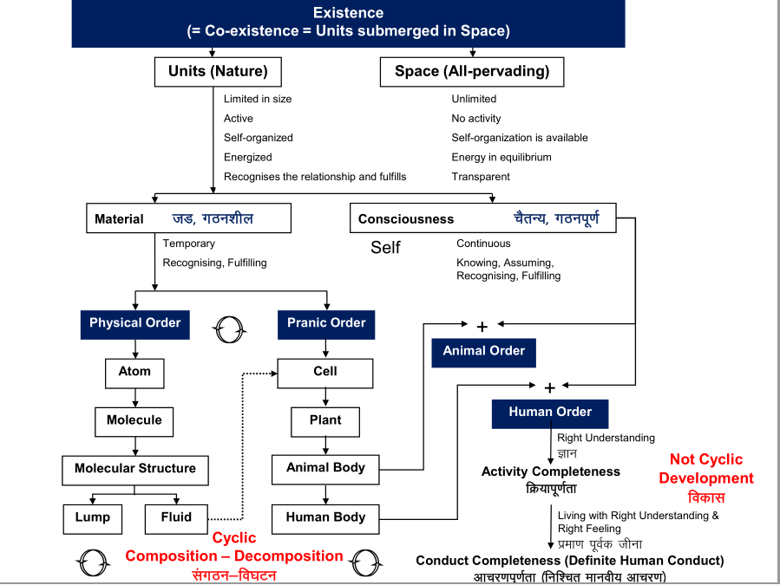
Existence is Co-existence
Sudhanshu Kumar KOE 069 & Universal Human Values 2 Unit I

Slide 52


Animal Consciousness: Living by Preconditioning & Sensation
 | Power | Dynamic Activity | State Activity
1. |  | Authentication | Realization
2. |  | Determination | Understanding
3. | Desire | Imaging | Contemplation
4. | Thought | Analysing | Comparing | Unguided Senses, Health, Profit
 |  | Selecting | Tasting | Unguided Sensation
  Self verification on the basis of Natural Acceptance
B1
3
Self (I)
eSa
Self (I)
B2
Body
Behaviour
Human
Work
Rest of Nature
Other
Sudhanshu Kumar KOE 069 & Universal Human Values 2 Unit I

Slide 53
Human Consciousness: Living on the basis of Knowing
Space
 | Power | Dynamic Activity | State Activity
1. |  | Authentication | Realization | Co-existence
2. |  | Determination | Understanding | Harmony in Nature
3. | Desire | Imaging | Contemplation | Participation in Larger Order, Relationship
4. | Thought | Analysing | Comparing | Co-existence, Harmony, Justice Guided Senses
5. | Expectation | Selecting | Tasting | Goal, Value Guided Sensation
B1
Self (I)
B2
Body
Behaviour
Human
Work
Rest of Nature
Participation
in larger Order
Other
Sudhanshu Kumar KOE 069 & Universal Human Values 2 Unit I

Slide 54
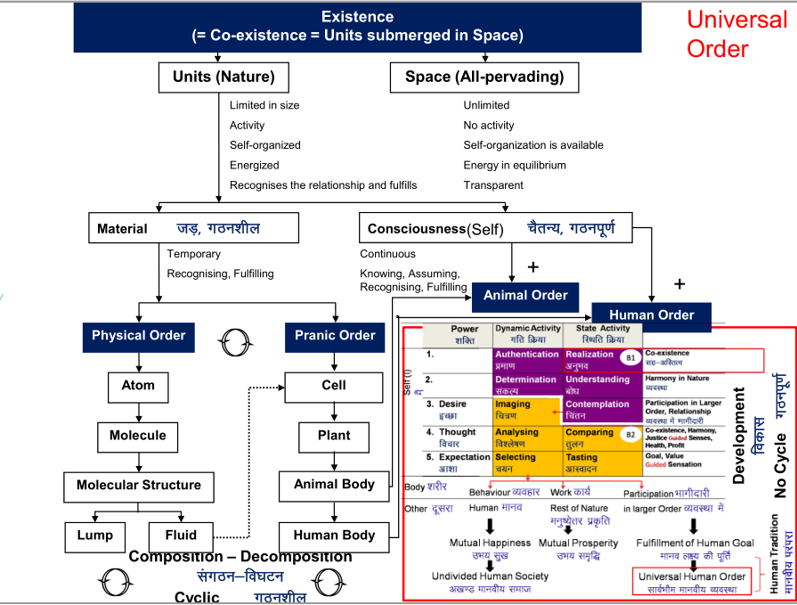
Existence = Co-existence
Sudhanshu Kumar KOE 069 & Universal Human Values 2 Unit I

Slide 55
Home Work
Having assumed / understood nature in detail, have you changed your living pattern, choices? (e.g. choice of food)
Sudhanshu Kumar KOE 069 & Universal Human Values 2 Unit I

Slide 56
Needs of Self (I) & Body
Co-existence
lgvfLrRo
Human Being | Self (I) | Body
Need | Happiness (e.g. Respect) | Physical Facility (e.g. Food)
In Time | Continuous | Temporary
In Quantity | Qualitative (is Feeling) | Quantitative (Required in Limited Quantity)
Fulfilled By | Right Understanding & Right Feeling | Physio-chemical Things
Activity | Desire, Thought, Expectation… | Eating, Walking…
In Time | Continuous | Temporary
Response | Knowing, Assuming, Recognising, Fulfilling | Recognising, Fulfilling
 | Consciousness | Material
Khushboo ROE- 074 & Universal Human Values 2 Unit I

Slide 57
Needs of Self (I) & Body
The transaction between the Self and the Body is only of information (no material transaction is taking place)
  Instructions from the Self to the Body
  Sensations from the Body to the Self
The decision for every transaction is made by the Self
  The decision to send instruction to the Body
  The decision to read sensation from the Body
Sudhanshu Kumar KOE 069 & Universal Human Values 2 Unit I

Slide 58
Understanding the body as an instrument of ‘I’
 | I | BODY
1 | I am | My body is
2 | I want to live | Body is used as an instrument (of ’I’)
3 | I want to live with continuous happiness | For nurture of body- food For protection of body- clothing, shelter For right utilization of body – instruments, equipment's, etc
4 | To understand and to live in harmony at all 4 levels is the program for my continuous happiness | Production, protection and right utilization of physical facilities is just a part of my program.
5 | I am the seer , doer and enjoyer | Body is an instrument
Khushboo ROE- 074 & Universal Human Values 2 Unit I

Slide 59
I am the Seer
“Seer” means the one that sees / understands
e.g. If you are given something in your hand and you conclude that it is a pen, it is not your eyes that concluded this. It is you that concluded this. The Self (I) sees via the eyes – the eyes don’t see themselves
Like that all the 5 senses are just the instrument that enable the Self (I) to see something outside
Thus, the Self (I) ‘sees’ or understands, sometimes with the help of the body, sometimes without the help of body
Sudhanshu Kumar KOE 069 & Universal Human Values 2 Unit I

Slide 60
I am the Doer
“Doer” means the one that does, who takes decision to do
I am the one who decides. I decide what to do, what not to do...
I may or may not use the body to do – what I think of is my decision. I do that thinking within myself (there is no role of the body in this)
If required, the body is used to express my decision
The Body is used as an instrument
Sudhanshu Kumar KOE 069 & Universal Human Values 2 Unit I

Slide 61
I am the Enjoyer (Experiencer)
“Enjoyer” means the one that experiences happiness / unhappiness
I am the one that feels enthused or depressed. I am the one that feels angry or delighted...
I am the enjoyer, the experiencer
Sudhanshu Kumar KOE 069 & Universal Human Values 2 Unit I

Slide 62
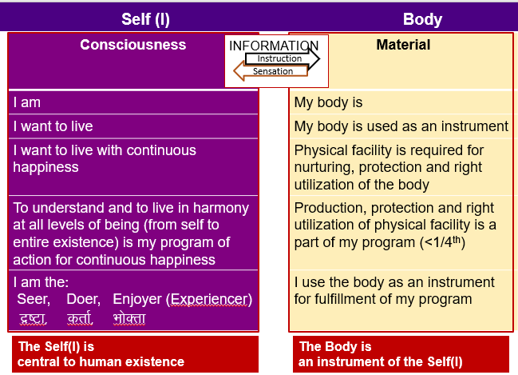
Self & Body
Sudhanshu Kumar KOE 069 & Universal Human Values 2 Unit I

Slide 63
Home Work
Are you able to see that your happiness and unhappiness depends on your own state of imagination? How much of your program for living is now based on happiness from within (harmony) and how much of it is based on happiness from outside (excitement) or running away from unhappiness?
Sudhanshu Kumar KOE 069 & Universal Human Values 2 Unit I

Slide 64
Continuous Happiness as the Basic Human Aspiration
In the light of investigation made so far, we can now see that:
  Basic human aspiration is for continuity of happiness. Aspiration for feeling of prosperity is in fact part of this continuity of happiness
  This is fulfilled by ensuring right understanding, right feeling and right thought
  This right feeling and right thought is called Resolution.
  Resolution in all aspects of our living calls for clarity about these different aspects of our living- in the self, with the body, in relation with human being and nature
Sudhanshu Kumar KOE 069 & Universal Human Values 2 Unit I

Slide 65
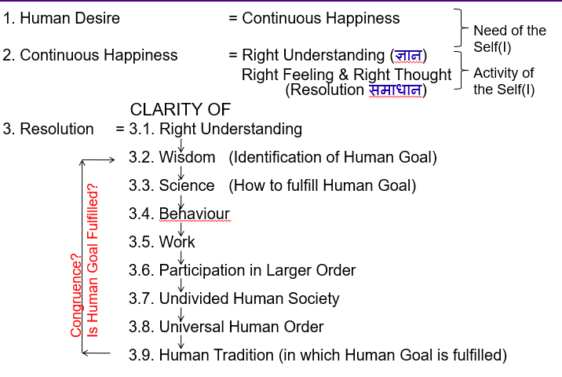
Human Target
Sudhanshu Kumar KOE 069 & Universal Human Values 2 Unit I

Slide 66
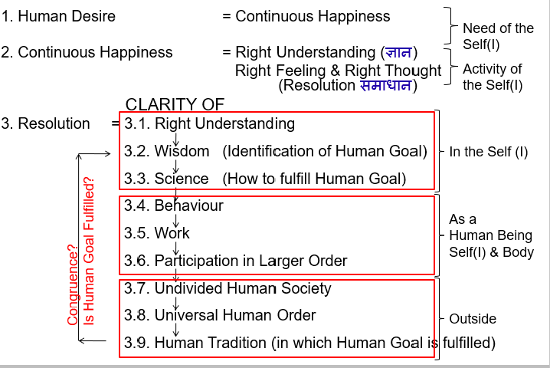
Human Target
Sudhanshu Kumar KOE 069 & Universal Human Values 2 Unit I

Slide 67
Placement of these Different Aspects of Our Living
If we recall total expression of human being living with realisation of co-existence (i.e. Human conduct) from UHV1,
These different aspects of our living – in the self, with the body, in relation with human being and nature – can be placed as shown in the slides to follow.
Sudhanshu Kumar KOE 069 & Universal Human Values 2 Unit I

Slide 68
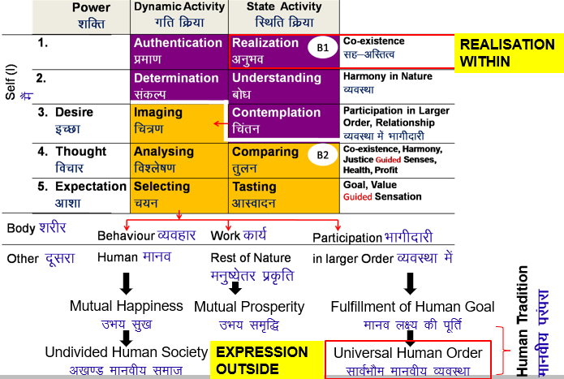
Realization of Co-existence & it’s expression – Universal Human Order
Sudhanshu Kumar KOE 069 & Universal Human Values 2 Unit I

Slide 69
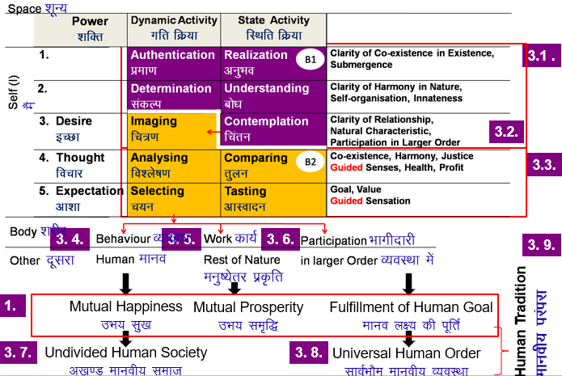
Realization of Co-existence & it’s expression – Universal Human Order
Sudhanshu Kumar KOE 069 & Universal Human Values 2 Unit I

Slide 70
Self-Exploration
Whatever is said is a Proposal (Do not accept it to be true)
Verify it on your own right
1
2
Experiential Validation
Live according to it
Verify
on the basis
Of
your
Natural
Acceptance
2a
2b
Behaviour with
Human Beings
Work with
Rest of Nature
Mutual Happiness
Mutual Prosperity
Which process is Naturally Acceptable to you?
A process of self-exploration on your own right, leading to understanding in your self
or
A process of discourse, do’s & don’ts, in which you assume what is said
Sudhanshu Kumar KOE 069 & Universal Human Values 2 Unit I

Slide 71
Daily Quiz
_________ deals with what is universally valuable to us, what is conductive to our individual and collective happiness and prosperity in a sustainable way.
Working only for physical facilities is living with ____________.
The basic requirements for fulfilling the aspirations of every human being are ___________, ________ & ___________.
Working for right understanding as the first priority followed by relationship and physical facilities implies living with _________.
Physical facilities are necessary as well as complete for a human being- True /False
Sudhanshu Kumar KOE 069 & Universal Human Values 2 Unit I

Slide 72
MCQ s
It is a process of dialogue between “what you are” and “what you really want to be”
Self-exploration b) Natural Acceptance
c) Value education d) None
Basic human aspirations are-
Continuous happiness b) Prosperity
Both d) None
_________ implies unconditional and total acceptance of the self, people and environment.
Natural Acceptance b) Happiness
c) Self- Exploration d) None
Sudhanshu Kumar KOE 069 & Universal Human Values 2 Unit I

Slide 73
Glossary questions
Explain the process of value education
What are the requirements to fulfill basic human aspirations?
What is the need for value education in technical and other professional institutions?
What do you understand by the value of an entity? What is the value of a human being?
What is the shift in our understanding/assumption through UHV2?
Sudhanshu Kumar KOE 069 & Universal Human Values 2 Unit I

Slide 74
Weekly Assignment 1
What do you mean by animal and human consciousness? Explain with help of diagram.
What are the requirements to fulfil basic human aspirations?
What is experiential validation? What is the state today and what is the way out?
Define self-exploration. Explain the process of self-exploration with the help of diagram.
What is the shift in our assumption through UHV1?
Sudhanshu Kumar KOE 069 & Universal Human Values 2 Unit I

Slide 75
Weekly Assignment 2
What is the meaning of ‘doer’ as described in the course? Explain with help of an example.
How does ‘Right Understanding’ relate to ‘Wisdom’? Explain.
What is the meaning of ‘enjoyer’ as described in the course? Explain with help of an example.
What is the shift in our understanding/assumption through UHV2?
What is the meaning of ‘seer’ as described in the course? Explain with help of an example.
Sudhanshu Kumar KOE 069 & Universal Human Values 2 Unit I

Slide 76
Faculty Video Links, Youtube & NPTEL Video Links and Online Courses Details
Youtube/other Video Links
1. What is Value Education-
https://www.youtube.com/watch?v=HLp5GzkDRvU&list=PLsh2FvSr3n7doww8dqQ9YIL2G66tWZQz3
2. Need for value Education-
https://www.youtube.com/watch?v=QFHOtH54oUc&list=PLsh2FvSr3n7doww8dqQ9YIL2G66tWZQz3&index=3
3. Self-Exploration-
https://www.youtube.com/watch?v=266BKAHHRu0&list=PLsh2FvSr3n7doww8dqQ9YIL2G66tWZQz3&index=7
Sudhanshu Kumar KOE 069 & Universal Human Values 2 Unit I

Slide 77

Old Question Papers
Previous University Papers can be studied from following links-
Explain the statement- Self is central to human existence.
With the help of a diagram, show the state of the Self without right understanding
Sudhanshu Kumar KOE 069 & Universal Human Values 2 Unit I

Slide 78
Expected Questions for University Exam
List some of the shifts expected from a student after attending the foundation course in Human Values.
By understanding the human being is not just the body, but a co-existence of Self and Body, list some of the qualitative shifts in living of a human being.
Explain the statement- Self is central to human existence.
What do you mean by animal and human consciousness? Explain with the help of a diagram.
Critically examine the prevailing notions of happiness and prosperity and their consequences.
Explain need and basic guidelines for value education?
With the help of a diagram, show the state of the Self without right understanding.
Sudhanshu Kumar KOE 069 & Universal Human Values 2 Unit I

Slide 79
Recap
Human Being is co-existence of Self(I) and Body
The Body is an instrument of the Self(I)
The transaction between Self(I) and Body is only in the form of information
The Self(I) is the seer, doer and enjoyer – it is central to human existence
The need of the Self(I) is continuous happiness
Basic human aspirations
  Continuous Happiness and Prosperity
Program to fulfil basic Human Aspirations
  Right Understanding, Relationships and Physical Facilities.
Transformation from Animal to Human Consciousness
Our Program: Understanding and living in Harmony at all levels.
  Production, protection and right utilization of physical facility is a part of my program
Sudhanshu Kumar KOE 069 & Universal Human Values 2 Unit I

Slide 80
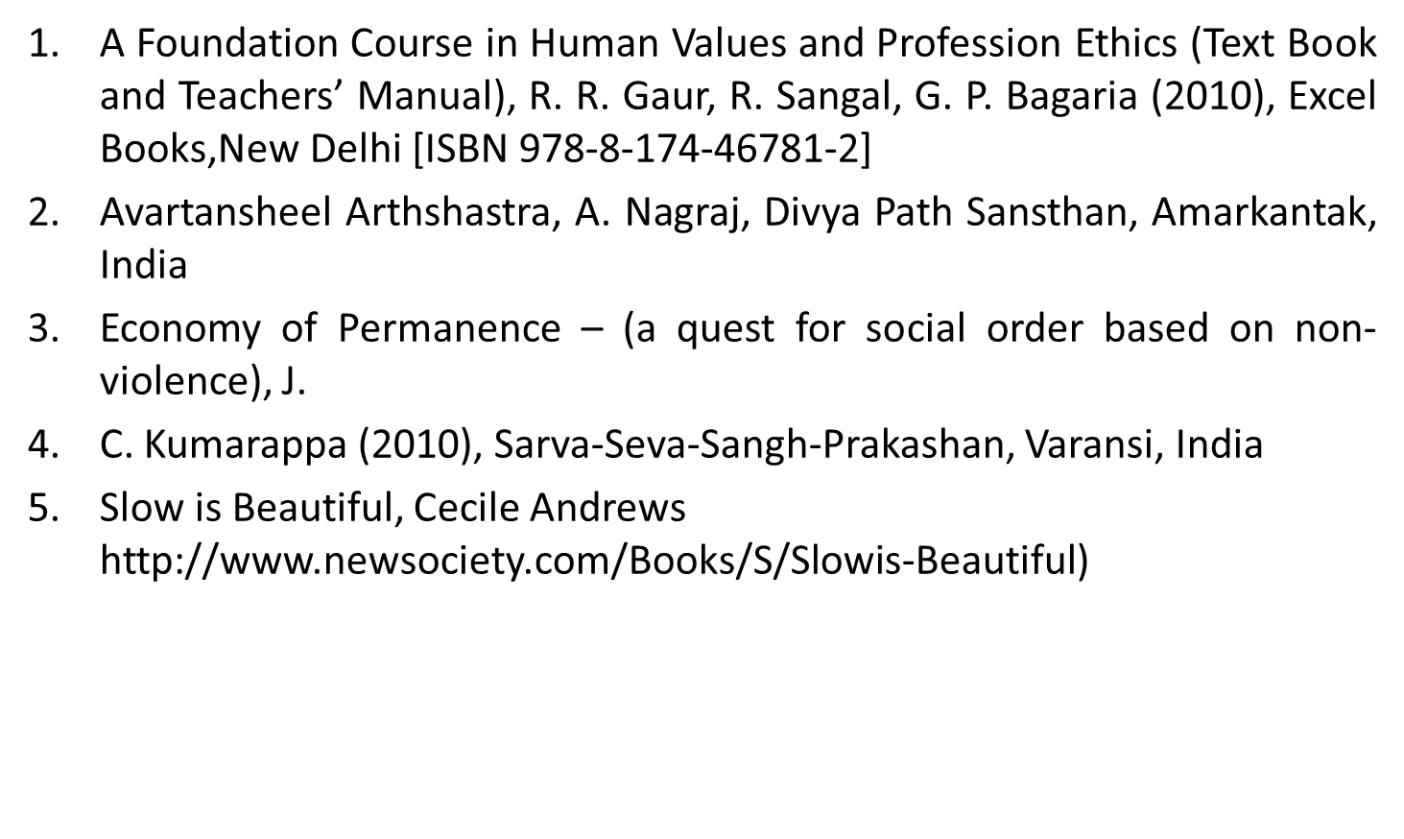
References
Sudhanshu Kumar KOE 069 & Universal Human Values 2 Unit I

Slide 81

Sudhanshu Kumar KOE 069 & Universal Human Values 2 Unit I

